Slide 1
Module 7 – interfacing of lcd

Slide 2
Introduction
There are 2 types of pins on the LCD module.
Some pins send data, and some pins are command pins.

Slide 3
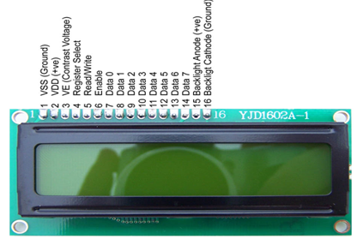
LCd interface

Slide 4
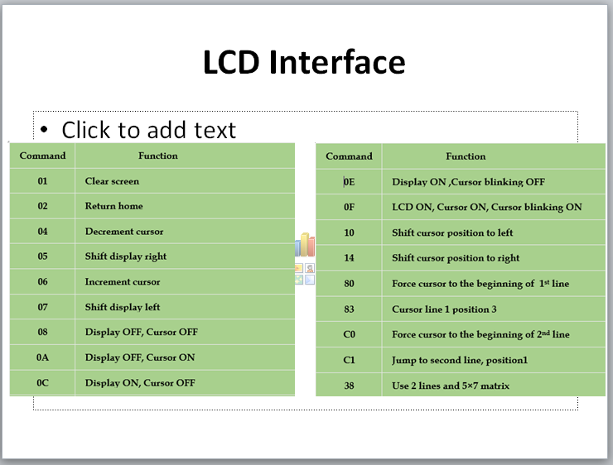
LCD Interface

Slide 5
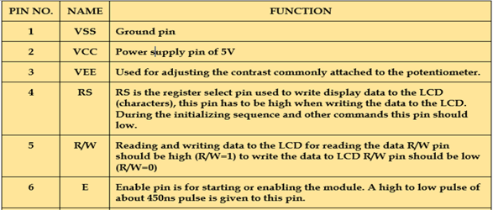

Slide 6
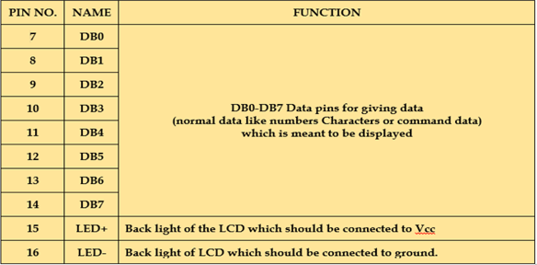

Slide 7
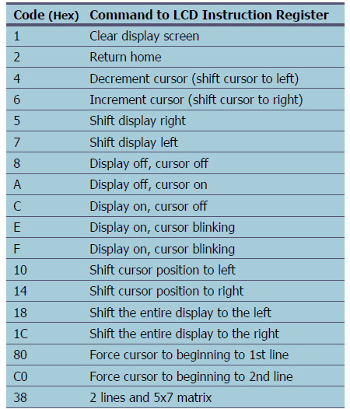
Commands

Slide 8
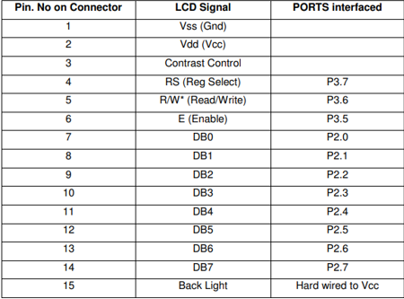
15-Pin flow strip connector for lcd interface

Slide 9
Example 1
void LCD_DATA(unsigned char DATA)
{
P2=DATA;
RS=1;
RW=0;
EN=1;
DELAY_ms(5);
EN=0;
}
void DELAY_ms(unsigned int j)
{
unsigned int i;
for(;j>0;j--)
{
for(i=250;i>0;i--);
for(i=250;i>0;i--);
}
}
#include <reg51.h>
void LCD_CMD(unsigned char CMD);
void LCD_DATA(unsigned char DATA);
void DELAY_ms(unsigned char j);
sbit RS= P3^7;
sbit RW= P3^6;6
sbit EN= P3^5;
void main(){
P2=0x00; /Port used to connect LCD datapins D0-D7
LCD_CMD(0x01); //Clear the display screen
DELAY_ms(5);
LCD_CMD(0x0E); //Display on, cursor blinking
DELAY_ms(5);
LCD_CMD(0x38); //2 lines, 5x8 matrix, 8bit mode
DELAY_ms(5);
LCD_CMD(0x80); //Force the cursor to the
DELAY_ms(5);
LCD_DATA('S');
LCD_DATA('E');
LCD_DATA('N');
LCD_DATA('S');
LCD_DATA('E');
while(1);
}
void LCD_CMD(unsigned char CMD)
{
P2=CMD;
RS=0;
RW=0;
EN=1;
DELAY_ms(5);
EN=0;
}

Slide 10
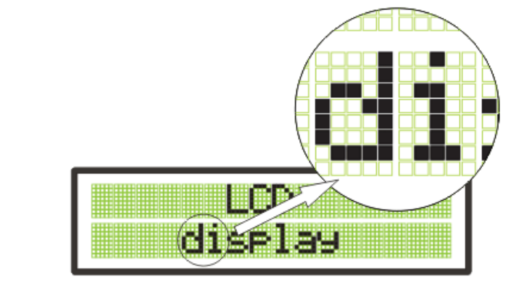
5x8 Dot matrix

